Slide 1
NBias: A natural language processing framework for BIAS identification in text
Group: 17
Protiva Das 24166051
CSE713

Slide 2
Abstract
Bias in textual data can lead to skewed outcomes and perpetuate discrimination, as algorithms may make biased decisions. To combat this, we created Nbias, a framework with four layers: data collection, corpus construction, model development, and evaluation. We sourced data from various domains, including social media and healthcare, using a transformer-based model to identify bias at the word level. Our approach improves accuracy by 1% to 8% over baselines and provides insights into model functioning, enhancing fair and ethical data use.

Slide 3
Introduction
The expansion of Natural Language Processing (NLP) applications, from recommendation systems to employment screening, has highlighted the critical issue of bias in these systems.
Bias often arises from the training datasets, leading to racial and gender discrimination, yet many NLP practitioners lack the awareness to address these biases effectively.
There is a significant gap in discussions about data specifics—its origin, generation, and preprocessing—in NLP research, underscoring the need for more rigorous scrutiny.
The objective of this research is to explore bias detection in NLP datasets, aiming to create fairer and more equitable AI systems.
Addressing biases is essential across various domains such as healthcare, social media, and recruitment, where NLP models influence decision-making processes.

Slide 4
Related Works
Bias in NLP systems, both explicit and implicit, leads to discriminatory outcomes that reinforce existing societal prejudices. [1]
Various methods have been developed to identify bias in training datasets, with statistical approaches being particularly prevalent [2]
The field of NLP has seen innovative approaches to bias detection, utilizing advanced machine learning techniques to improve fairness. Studies have integrated speech detection systems with explanatory mechanisms to identify and explain biases. [3]

Slide 5
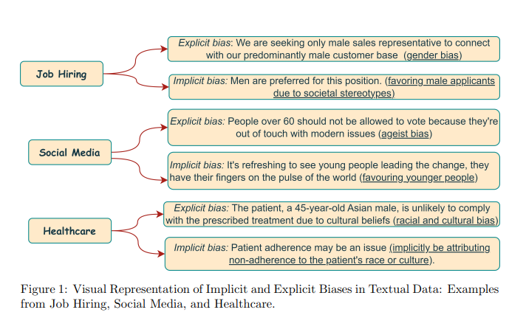
Methodology
Dataset:
MIMIC-III, MACCROBAT, Job Hiring, or BABE.
Data Analysis:
F1-scores of 86.9% in social media, 89.1% in healthcare, and 90.3% in job hiring, showing its robustness in bias mitigation across different domains.

Slide 6
Result Analysis
Social Media Bias: Nbias model achieved an F1-score of 86.9% with a low standard deviation of ±0.2, indicating a consistent and superior performance compared to other models in this category.
Health-related: In the health domain, Nbias outperformed all baselines with an F1-score of 89.1% and a deviation of ±0.8, showing minor variability and high reliability in results.
Job Hiring: The model scored exceptionally well in the job hiring sector with an F1-score of 90.3% and a standard deviation of ±0.4, the highest score across all tested categories, demonstrating its robustness.
Comparative Analysis: Among the competing models, TENER performed best after Nbias. However, other advanced models like BERT-CRF and RoBERTa also showed good performance, but not as consistent or high as Nbias, which also featured superior debiasing capabilities.

Slide 7
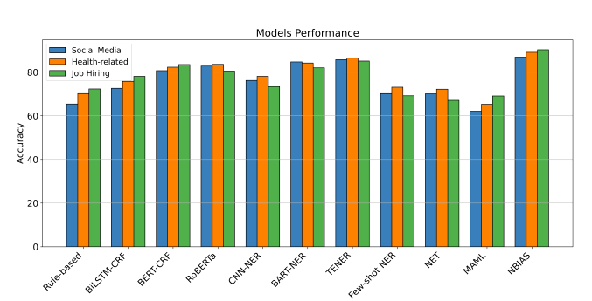

Slide 8
Referencing
Caliskan, A., Bryson, J. J., & Narayanan, A. (2017). Semantics derived automatically from language corpora contain human-like biases. Science, 356(6334), 183-186.
Bolukbasi, T., Chang, K. W., Zou, J. Y., Saligrama, V., & Kalai, A. T. (2016). Man is to computer programmer as woman is to homemaker? debiasing word embeddings. Advances in neural information processing systems, 29.
Cai, Y., Zimek, A., Wunder, G., & Ntoutsi, E. (2022, October). Power of Explanations: Towards automatic debiasing in hate speech detection. In 2022 IEEE 9th International Conference on Data Science and Advanced Analytics (DSAA) (pp. 1-10). IEEE.

Slide 9
Thank You
Any Questions Or Suggestions?

